Slide 1
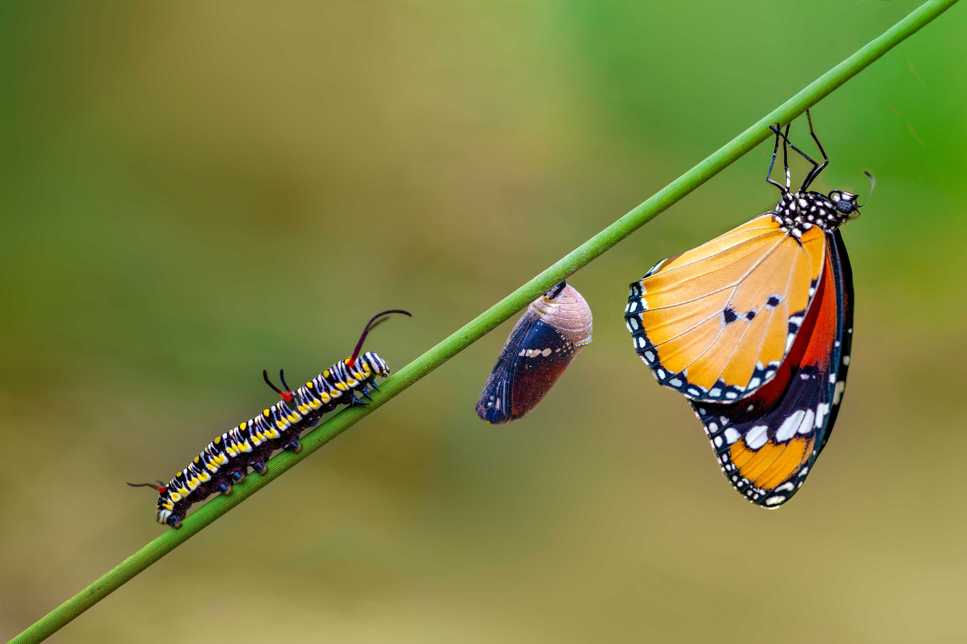
Code with Honor
on the importance and beauty of software programming Lucas Jellema – AMIS | Conclusion

Slide 2

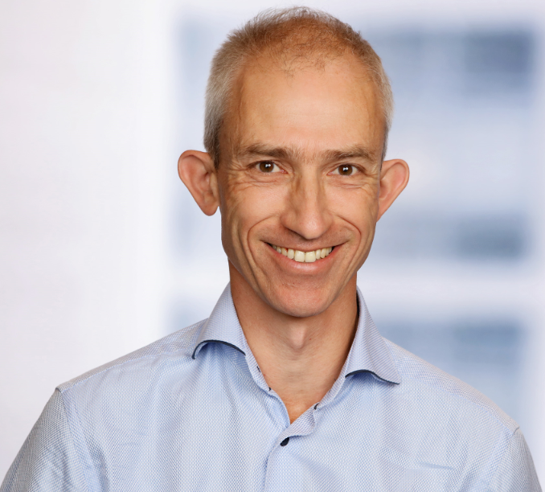
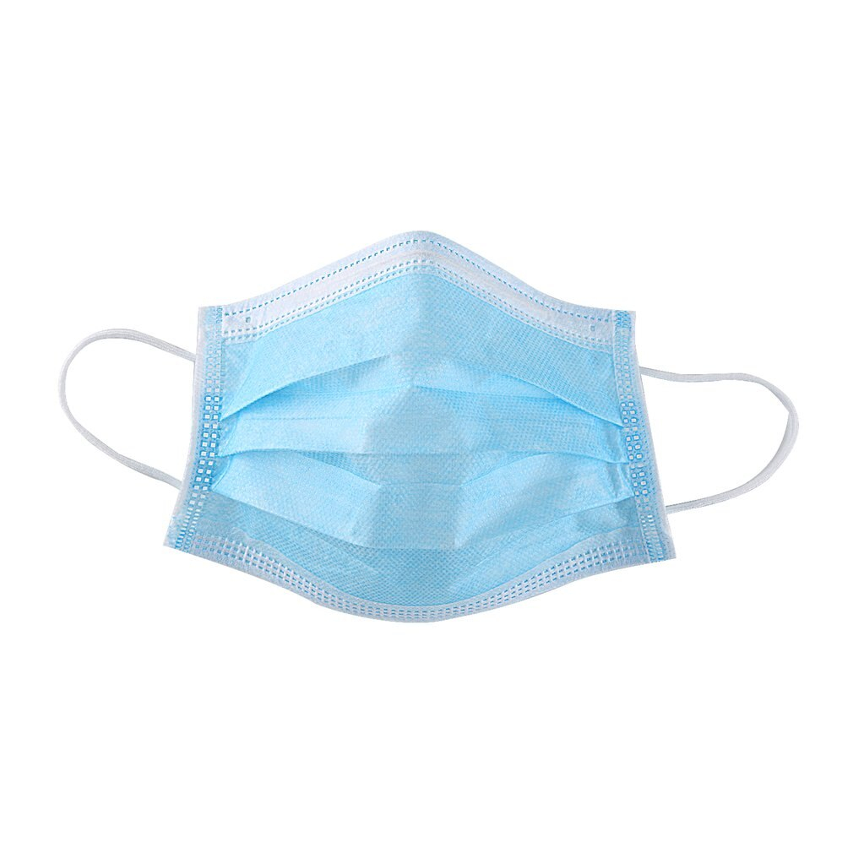
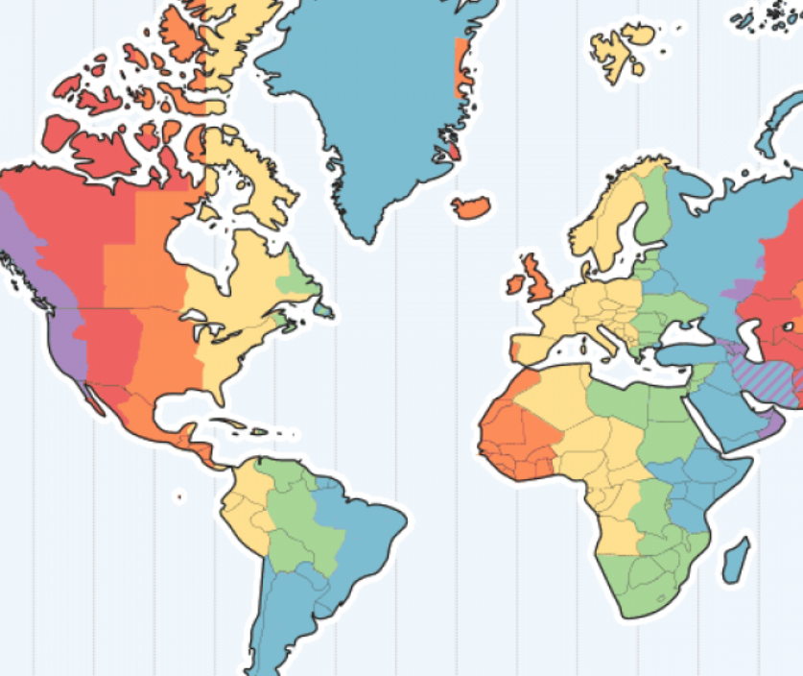
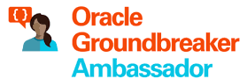





Lucas Jellema CTO for AMIS | Conclusion Cloud Solution Architect
8 hours
lucas.jellema@amis.nl | technology.amis.nl | @lucasjellema | lucas-jellema

Slide 3
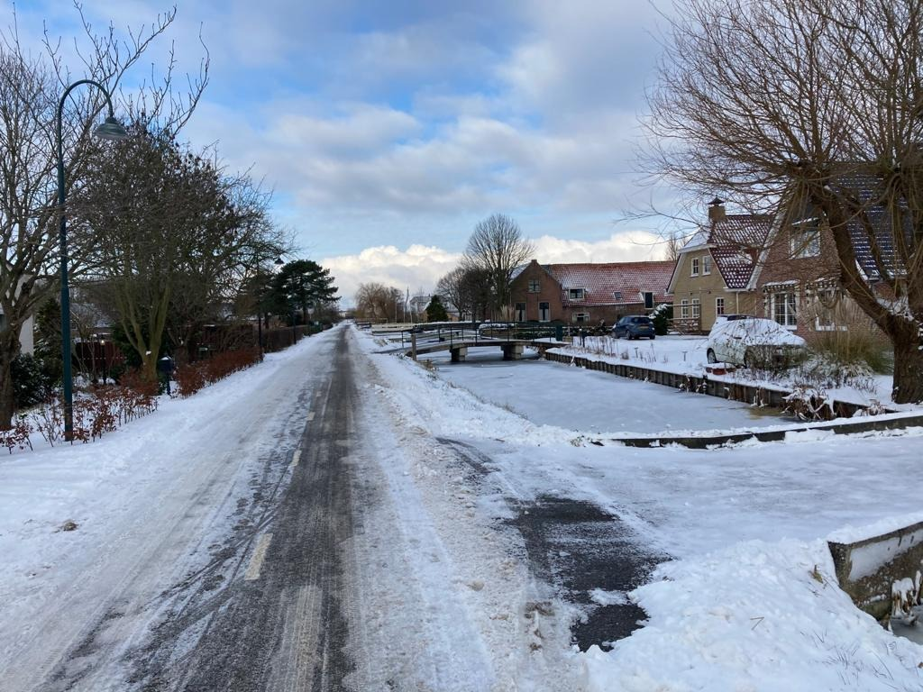
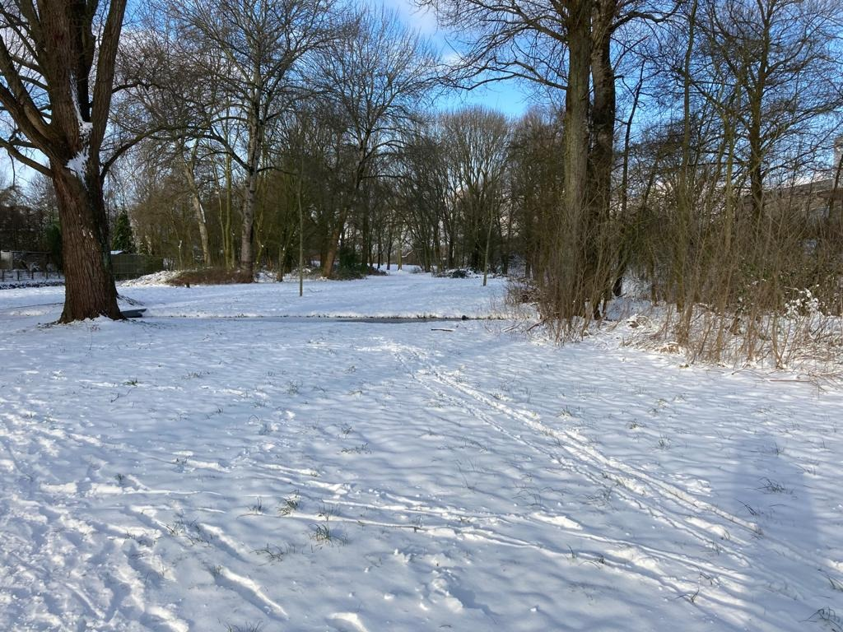

Slide 4

Quiz time

Slide 5
1202
Notes:
https://www.slideserve.com/ayala/se-3910-real-time-systems

Slide 6
1202

Slide 7
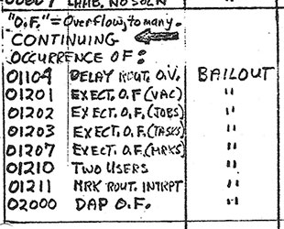




1202

Slide 8
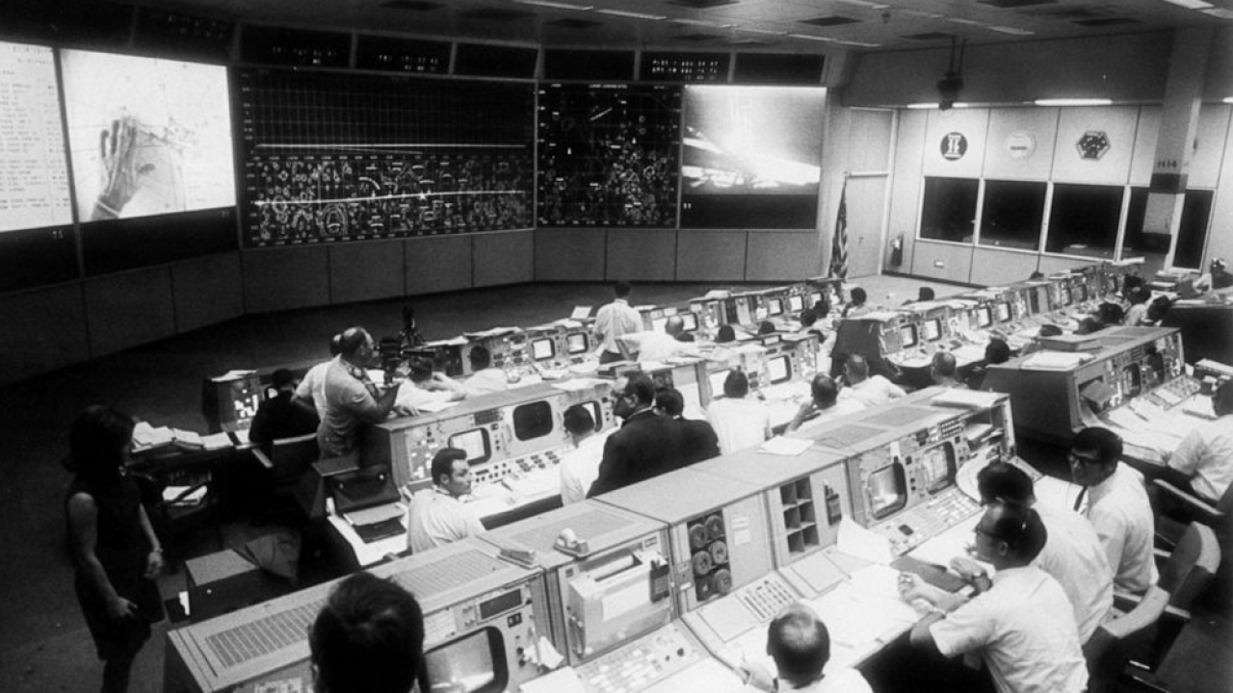
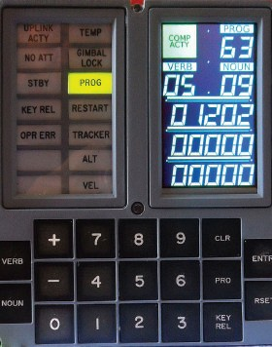


Slide 9
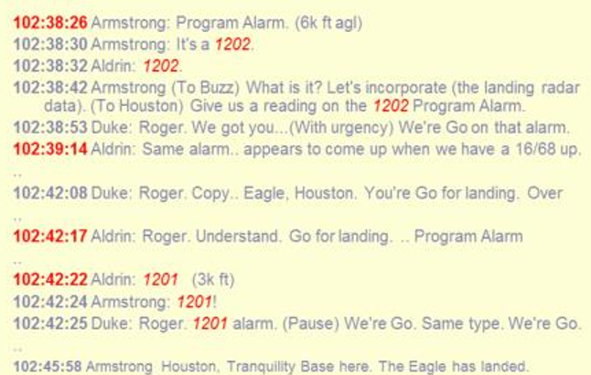
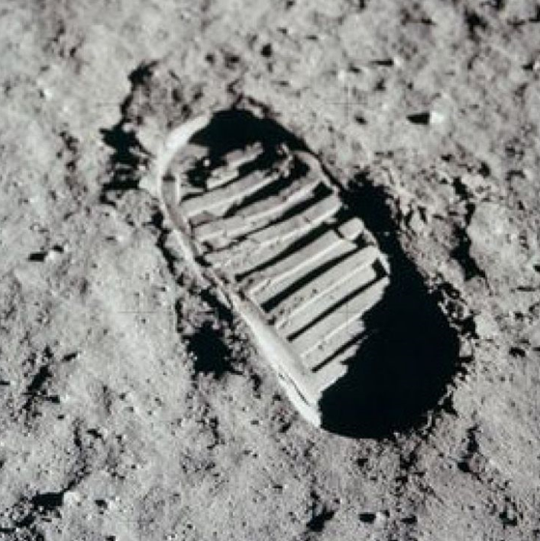
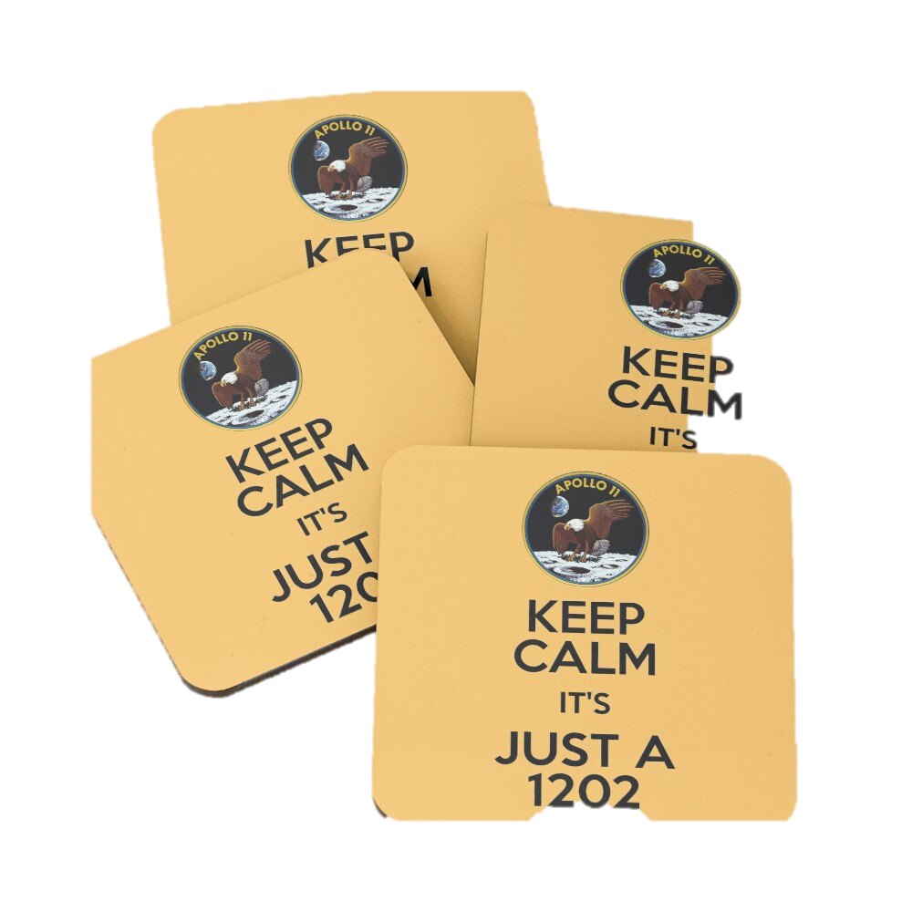
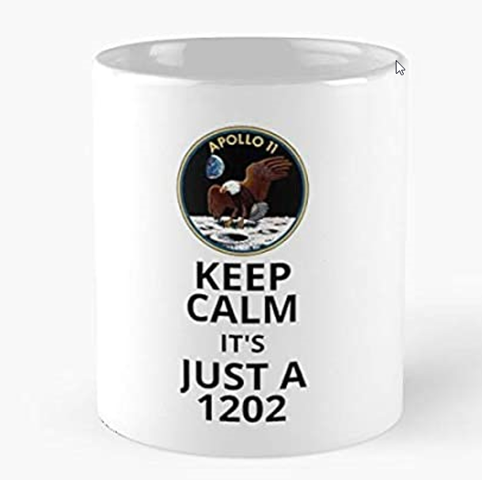



Slide 10
PR

Slide 11
Put to Rest
Periodic Review
PuRpose
Public Relations
Public Responsibility
PRoof
PRofessional
PRide
Push-button Release
oPeRate
PR
Pull Request
Peer Review
Production Ready
PR oductive

Slide 12
PRofessional
Put to Rest
PRide
Push-button Release
Periodic Review
PRoof
PR
Pull Request
Peer Review
Production Ready
oPeRate
PuRpose
Public Relations
Public Responsibility
PR oductive

Slide 13
PRofessional

Slide 14

Professional Software

Slide 15
Professional Software

Slide 16
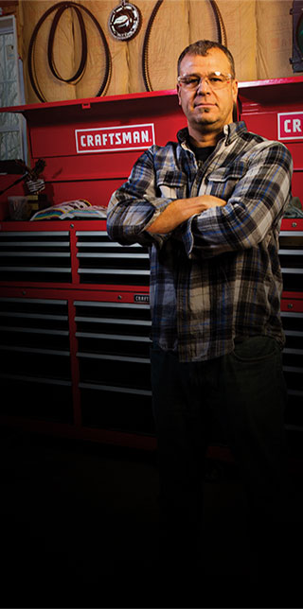

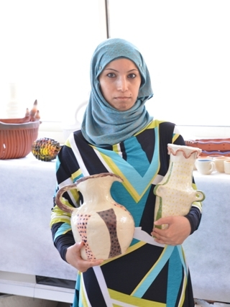

We are Proud Craftsmen

Slide 17
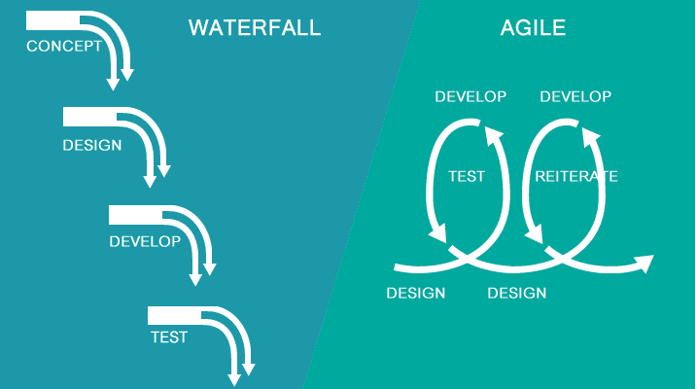
The Business

Slide 18
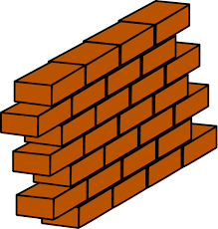


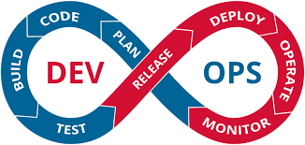
Development
scale, performance, security, stability, recoverability, monitoring
Production

Slide 19
MVP and incremental value delivery
go live
no value!

Slide 20

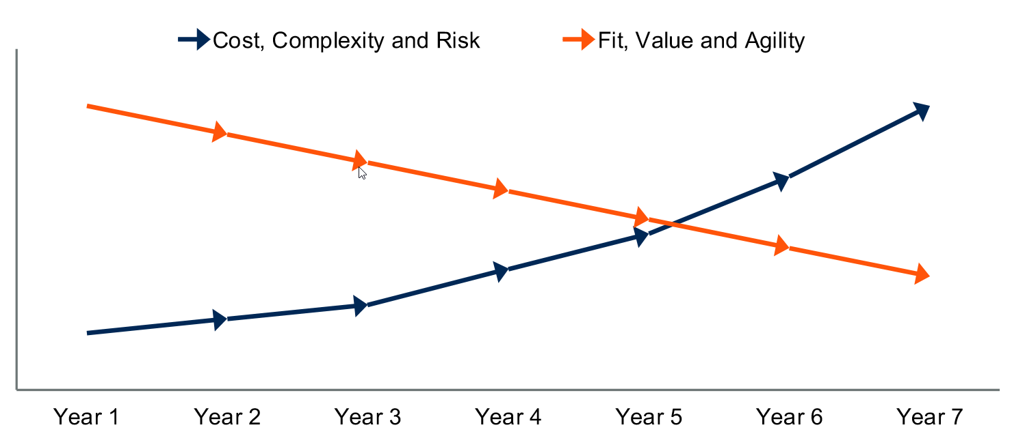


Lifetime of a software application

Slide 21

Paid Lip Service
Testing
QA
CI/CD
Automation
Scalability
Production-like testing environments
Security
Architecture | Design Patterns

Slide 22
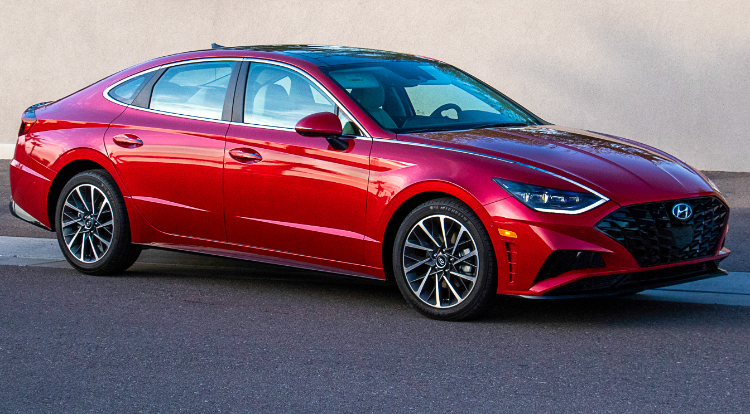
The Brake System is powered by Software
Your mother-in-law is about to get into the car
Your mother-in-law is about to get into the car
Your kids are about to get into the car
The quality of the brake software is similar to the code that you (or your team) committed last week

Slide 23
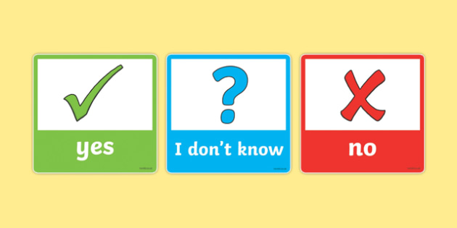
how do you know?
how do you know for sure what your software does and how it deals with real life?
why not?
what is your software good enough for? for a demo, a PoC or a strictly controlled prototype?
good enough to go to ACC (and let them find the bugs)?

Slide 24
Quiz time

Slide 25
What would you prefer:
We have no failing tests
We have some failing tests

Slide 26
What would you prefer:
We have no failing tests
We have some failing tests

Slide 27
What would you prefer:
We have 10% failing tests
We have 17.61 % failing tests

Slide 28
Professional Software
About me

Slide 29

About you as well?
A software professional who wants to
be proud of the professional software that you craft
take responsibility
towards society

Slide 30
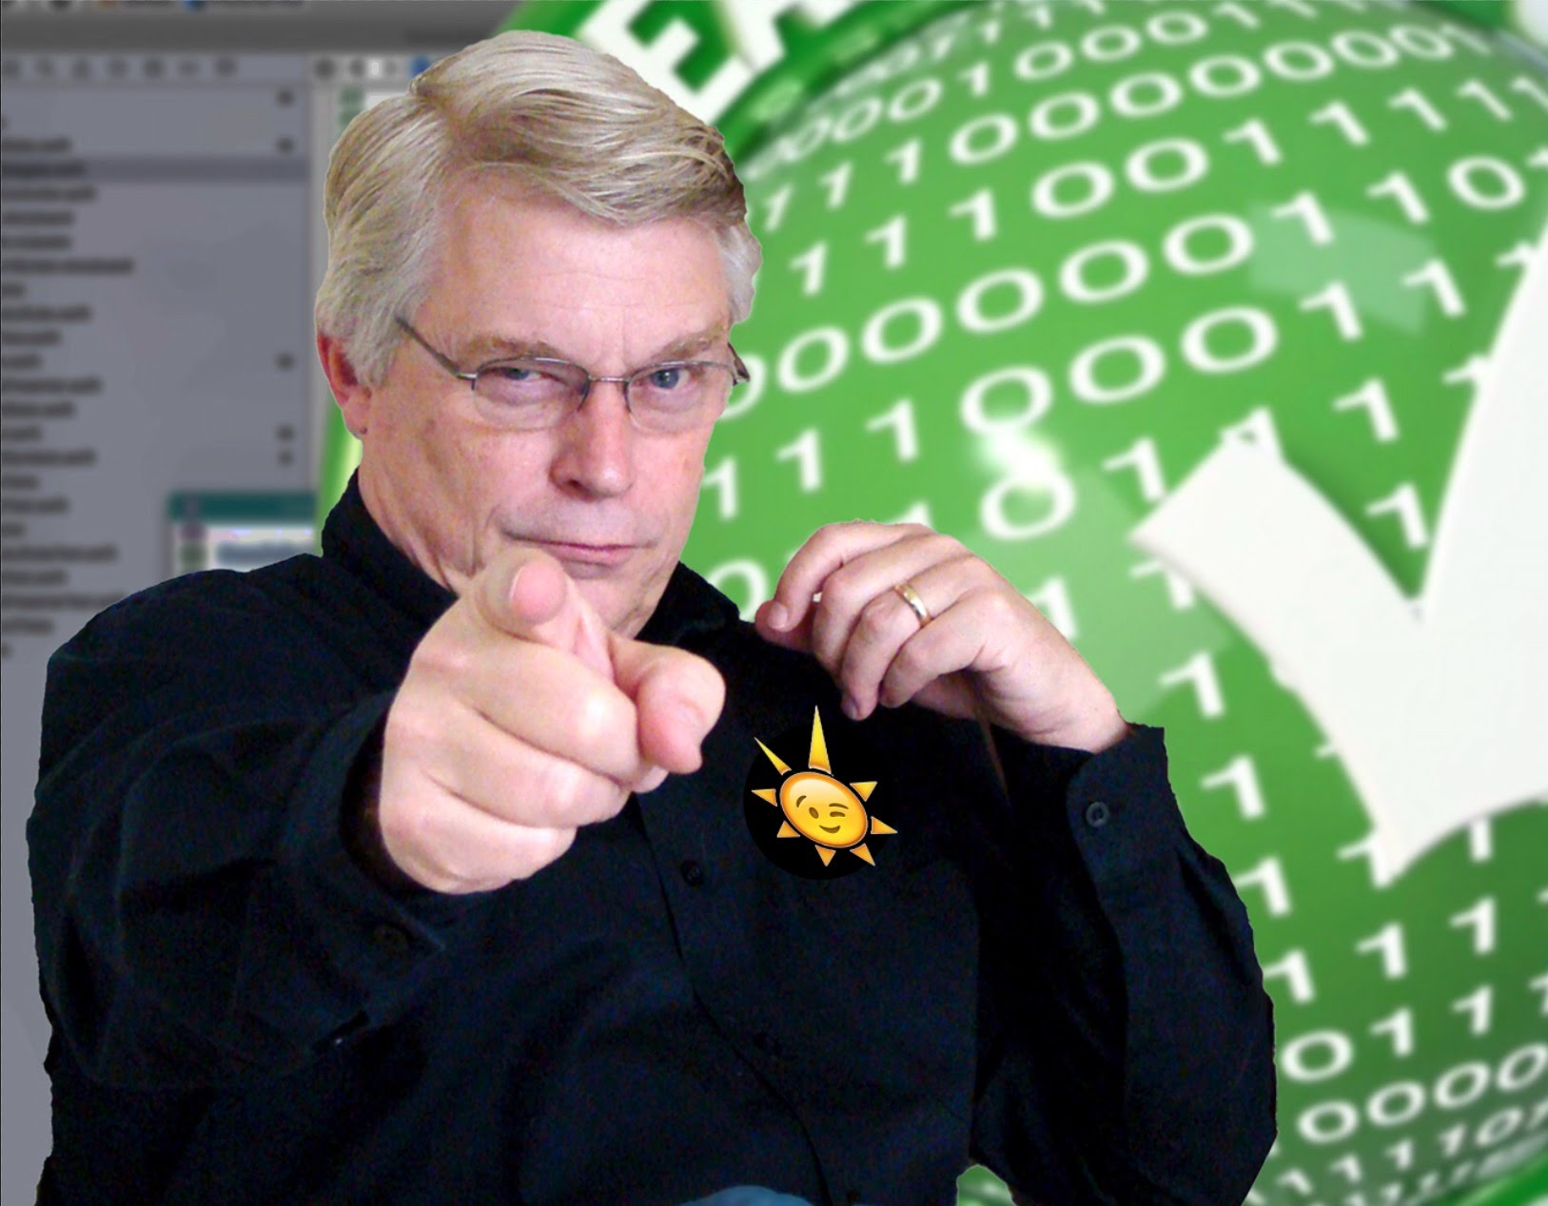
My awakening
So much software
So much dependency in society
health and safety, basic needs, education, climate, business success & failure, fun and comfort
Are we professionals? Can we be entrusted? Do we trust ourselves?
Are we proud of the work we deliver?

Slide 31

source: https://www.futuristgerd.com/2016/05/my-presentation-at-innotown-2016-in-alesund-the-next-5-years-in-technology-and-innovation/
Notes:
https://www.futuristgerd.com/2016/05/my-presentation-at-innotown-2016-in-alesund-the-next-5-years-in-technology-and-innovation/

Slide 32

My Central Heating Guy
Functioning system: heating and shower get water with requested temperature (fast enough and in sufficient volume)
Within reasonable boundary conditions (-20° to 30° outside temperature) Safe & According to regulations Limited noise production, limited gas
Lasts a while (10-20 years) – robust, limited wear & tear
Not often failures, after failure system can be started again quickly
Can be adapted to (small) changes in circumstances such as renovation of the house
Maintenance: not too often and not too expensive CV technicians that can work with the system are widely available, as well as spare parts: the system is not very outlandish

Slide 33
My Central Heating Guy
Functioning system: heating and shower get water with requested temperature (fast enough and in sufficient volume)
Within reasonable boundary conditions (-20° to 30° outside temperature) Safe & According to regulations Limited noise production, limited gas
Lasts a while (10-20 years) – robust, limited wear & tear
Not often failures, after failure system can be started again quickly
Can be adapted to (small) changes in circumstances such as renovation of the house
Maintenance: not too often and not too expensive CV technicians that can work with the system are widely available, as well as spare parts: system is not very outlandish
*) We expect a professional to offer suggestions and bring up relevant items that I am unaware off as a layman

Slide 34

My Software Guy
Functioning system: proof of working according to specifications – under all foreseeable conditions
Satisfies non-functional requirements (performance, availability, recovery of data & service) Safe & According to regulations Known and reasonable TCO
Lasts a while (10-20 years) – robust, limited wear & tear
with regular technical maintenance at normal costs
Can be adapted to changes in functional and non-functional requirements (scale, availability, performance, security, …)
Maintenance: not too often and not too expensive Software can be operated and maintained by regular IT staff
no rare super specialists need to be flow in
support and upgrades are easily available
*) We expect a professional to offer suggestions and bring up relevant items that I am unaware off as a layman

Slide 35
Do most systems live up to these expectations?
Does your software?
Does mine?

Slide 36
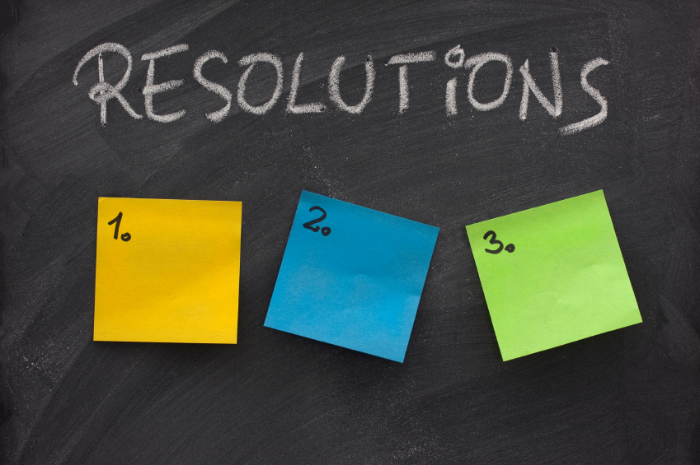
Code with Honor
Be proud
Take responsibility
Hone skills and craftmanship
Focus on longevity
Be honest
Be productive
Realize value
Team up
Step up
No concessions to my professionalism

Slide 37
Code with Honor
Be proud
Take responsibility
Hone skills and craftmanship
Focus on longevity
Be honest
Be productive
Realize value
Team up
Step up
No concessions to my professionalism

Slide 38
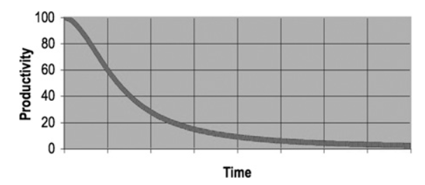
Productivity as function of time and code quality

Slide 39
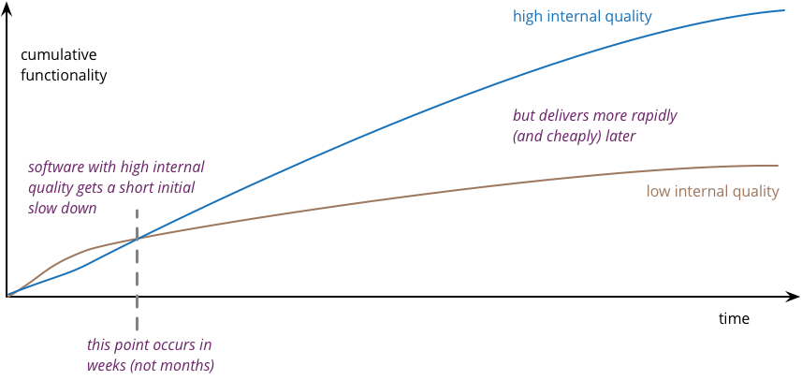
Productivity as function of time and code quality
source: https://martinfowler.com/articles/is-quality-worth-cost.html

Slide 40
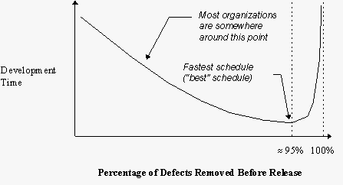
Productivity as function of % Defects Removed
source: The Economics of Software Quality - https://dev.to/bosepchuk/the-one-chart-every-developer-must-understand-2db9.
Notes:
https://dev.to/bosepchuk/the-one-chart-every-developer-must-understand-2db9
Capers Jones with co-author, Olivier Bonsignour titled The Economics of Software Quality.

Slide 41
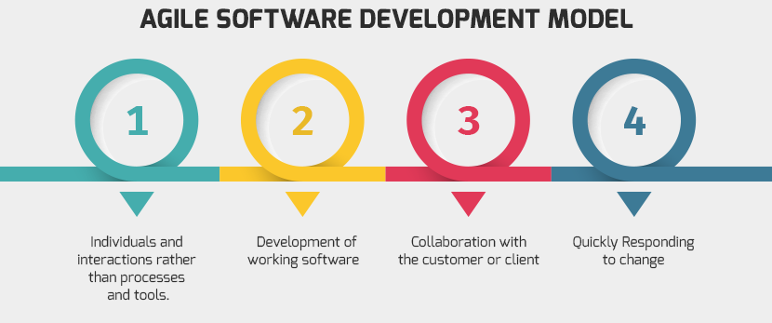
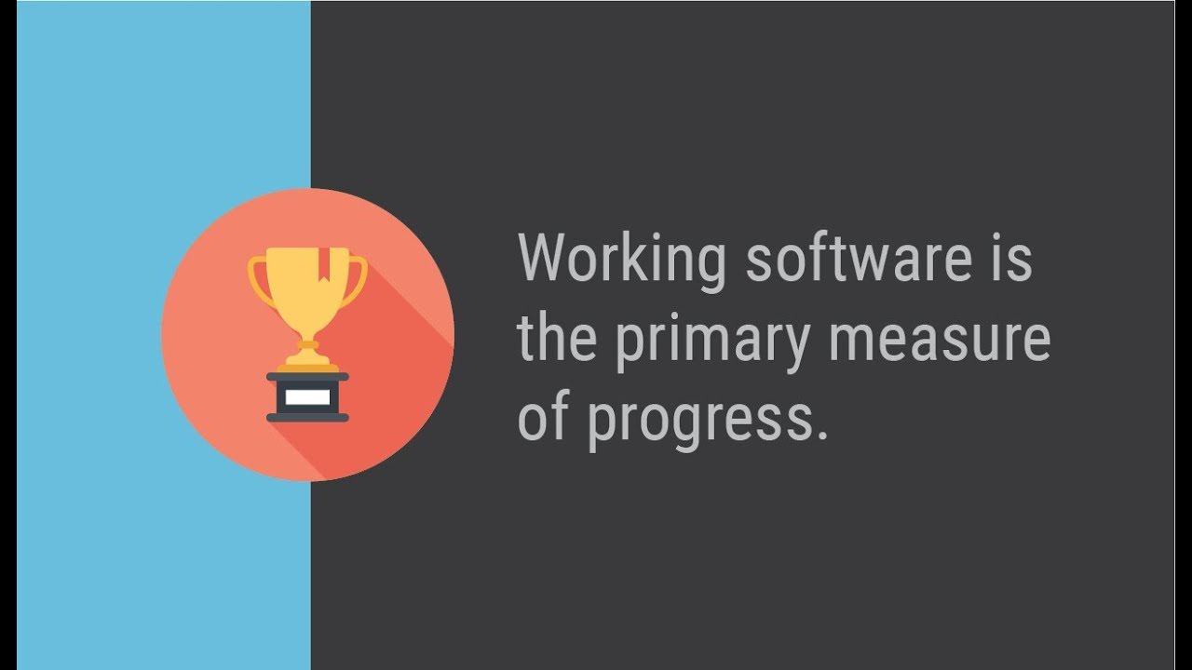

Slide 42
Working Software
What work does it do?
How can you tell?
Working Software

Slide 43
Small step for mankind…
From Working Software
To Professional software

Slide 44

Professional Software is ABLE Software
Verifi
Test
Oper
Read
Evolv
Maintain
Observ
Scal
Recover
Prov
Afford
Deploy
Audit
Impenetra
ABLE

Slide 45
What is software?

Slide 46
What is software? Any instruction executed by a machine!

Slide 47
Types of code - with distinctions in test, management, release , monitoring
Busines Run Time
Application
Tools for Design & Development & Test & Process
Platform
Deploy/Provision Time
Infrastructure
Notes:
Mergeable
Granularity/unit of… delivery/build/
Code analysis
Structured (declarative)

Slide 48

Not all code is created equal
Demo in presentation or workshop
Explorative / R&D / Doodles
Assignment in study or training
Snippet in a blog-article
Proof of Concept
Prototype
MVP
Alert Condition evaluation
Product with a very short time to live (several weeks, not any longer)
Contribution to open source project
(internal) Reusable Library
Operating system for guided nuclear missile/ SpaceX vehicle
Unit-test for code component
Healthcheck/smoketest
Not Production Ready: not (necessarily) Professional Quality Software
(potentially) Production : Professional Quality Software

Slide 49

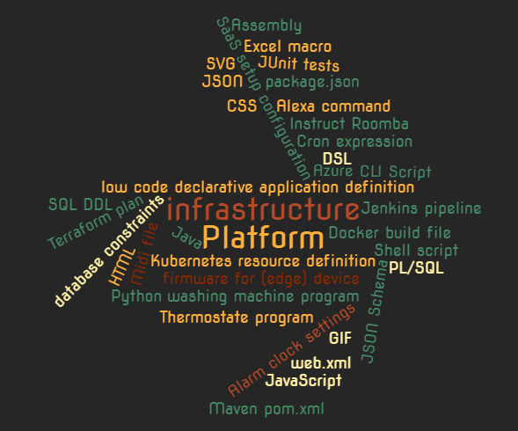
Everything is Code

Slide 50

Case in point
business critical
old
legacy
not modern
custom software
Notes:
not extraordinary!
Old, not modern
5TB in RDBMS, 50 applications, 2000 components/programs, 1.5M “lines of custom code”
fragile/issues
end of scale
stagnant / no innovation or evolution (SoR)
Expensive TCO
Critical to business
No test sets, no specifications, no documentation
Low on expertise: with tech stack, functionality, development and ops
pile of tech debt – business always in a hurry, IT caved in; no budget to technical upgrades/maintenance
Vulnerable

Slide 51
Case in point
high technical debt
no tests, no specs, no docs
end of scale
fragile
no evolution
low on expertise
expensive TCO
Notes:
not extraordinary!
Old, not modern
5TB in RDBMS, 50 applications, 2000 components/programs, 1.5M “lines of custom code”
fragile/issues
end of scale
stagnant / no innovation or evolution (SoR)
Expensive TCO
Critical to business
No test sets, no specifications, no documentation
Low on expertise: with tech stack, functionality, development and ops
pile of tech debt – business always in a hurry, IT caved in; no budget to technical upgrades/maintenance
Vulnerable

Slide 52

little expertise left on applications and tech stack
full command
of applications and technology
robust
high technical debt
old
business critical
controlled technical debt,
moving to technical solvency
business critical
end of scale
high incident rate
productivity
scalable
no tests, no specs, no docs
automation everywhere
no evolution
unsupported
supported technology (N or N-1)
continuous everything
modern
security-challenged
inflexible
as secure as needed
agile
cloud
not modern
expensive: high TCO
pay per use, business value for money
fragile
legacy
resilient
longevity
custom software
monolith
buy before build
agile architecture
unattractive technology stack for young talent
appealing technology stack for young talent and experienced staff
business ⬄ IT gap
well aligned business & IT

Slide 53

Notes:
technical erosion
slowly eating away

Slide 54
Working Software
Working Software

Slide 55
Working => Professional Software
Professional Software
Working Software

Slide 56
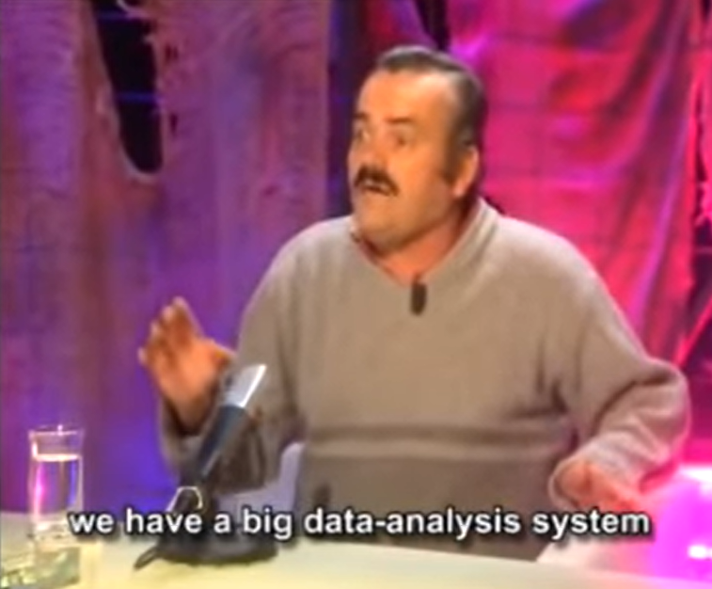
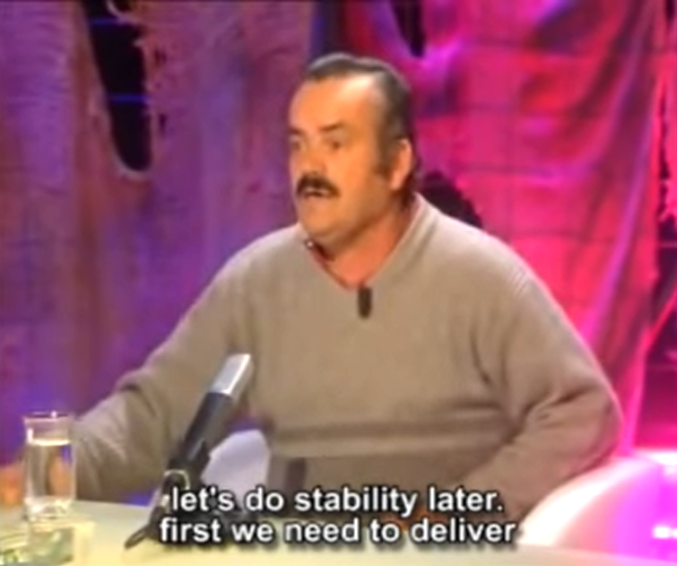
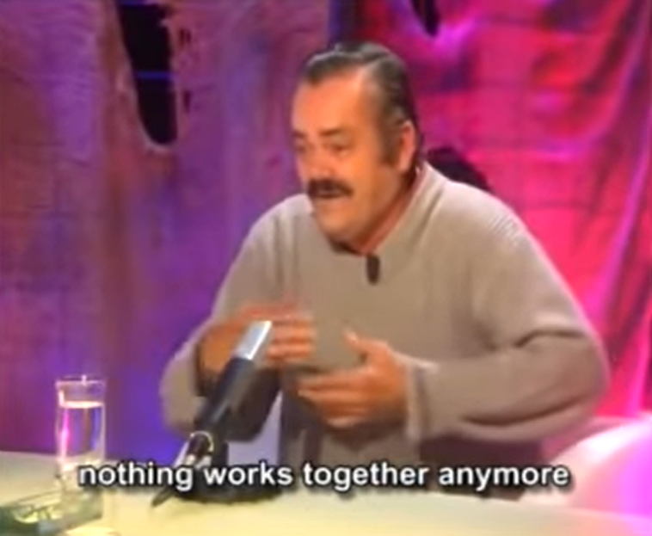
https://www.youtube.com/watch?v=5p8wTOr8AbU
Notes:
Jesús Quintero tells what happened to him when he went to work at a chiringuito in Chipiona and they sent him to clean some paella pans in Ratones Coloraos, Canal Sur.
use first 2 minutes

Slide 57
Working => Professional Software
Professional Software
Working Software

Slide 58




Stages in Software Lifecyle
Put to Rest
Professional & ABLE: Live Software (under Ops)
oPeRate
Production
DoD
Preparation
Deployable Software = DONE
Pull Request
Peer Review
Production Ready
Built Software
DoaD
Team
Professional Code
Developer
Working Software
DoR
Team
PRoof
Functional Specification
Behavior & Unit test

Slide 59
Working
according to functional specifications and technical interfaces
proven
Working Software

Slide 60

Behavior Test
The required behavior as experienced from the outside
specify
document
verify
Working Software
DoR
Functional Specification
Behavior test
Team

Slide 61

Unit Test
Verify behavior of
APIs & Interfaces
Reusable elements
Algorithms
Aspects
Functionality
Non Functionality
Happy & Non-Happy
not: dependencies

Slide 62

Test is many things
Functional contract (specification and documentation)
Quick (REPL) feedback cycle for developer
Proof of “working”
Insulator that allows
refactoring and code optimizations
technical upgrades
Regression detector
for things changed
Health indicator & Smoke detector
Reference for (re)using code
and things unchanged but impacted by changes

Slide 63

Who creates the test?
and at what time?
Who (or what?) executes the test
at what moment | trigger?
what is the outcome
Who checks on the tests?
specification coverage
code coverage
[real world] condition coverage
timely execution of test and handling of result

Slide 64

Definition
functional specifications clear, unambiguous and understood
boundary conditions, non happy cases and exceptional situations are covered in specifications
non-functional requirements are clear
business value of feature is defined
TCO budget
Notes:
Test can only be created when story is ready
DoR
functional specifications clear, unambiguous and understood
boundary conditions, non happy cases and exceptional situations are covered in specifications
Non Functional Requirements are clear
Business Value of feature is defined
TCO budget
Reference architecture
Design & implementation guidelines
Technical Debt

Slide 65
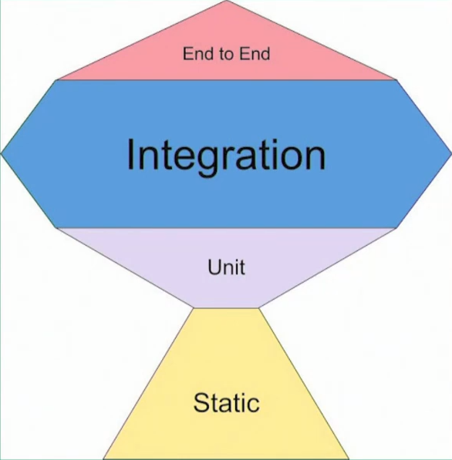
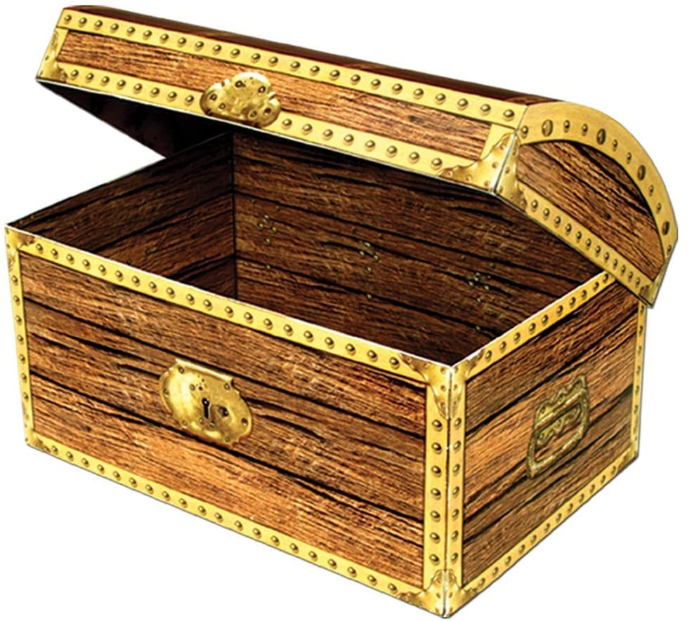
Test Trophy
Live
Test Data

Slide 66
Types of Tests
Live
ISOLATION
more
less
Unit Test
isolated
sociable/ wired
Integration Test
Static Code Analysis
End to End Test
Smoke Test | Health Check
Chaos Test

Slide 67
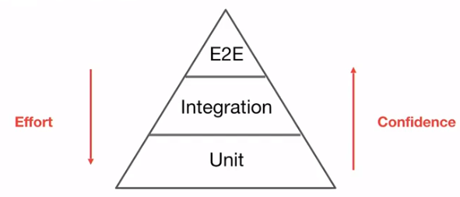
Types of Tests
ISOLATION
more
less
More:
Speed
Tests
Boundary Testing
Non-happy flows & corner cases
Mocks
Maintenance
Refactoring Protection
Technical
More:
Functional / Specification driven
Confidence
Bugs caught
Contract & Interaction
REAL (mocks poke holes in reality)
Side effect
Effort (per test)
Execution time
Unit and (most of) its internal dependencies; external dependenices are mocked
Unit Test
isolated
sociable/ wired
Integration Test
single unit, all dependencies are mocked
(aka Integration or BroadStack) test: tests include (unmocked) external dependencies; parts of the system can still be mocked
When used at runtime – E2E tests function as Smoke Test/Health Check – to test health of interactions at PaaS & IaaS level
Static Code Analysis
End to End Test
Verify code quality guideline adherence – without running any code
Some external dependencies are mocked; all internal units are used unmocked
Smoke Test | Health Check
Chaos Test
Tests in full blown environment (ACC, PROD); focus on (continuous) health – end to end availability of connections, permissions, platform and infra components; focus on important functional flows

Slide 68
Other Types and Scopes of Tests
Integration Test
Only mocks at the far ends of the chains
Smoke Test/Health Check
Live environment, no mocks
Live test data set (with no business side effects)
System
Smoketest

Slide 69
Application Architecture
External Systems
External Systems
Frontend (web, chat, public API)
API/
Internal Interface
Business Logic
External Systems
Persistence
(of state) – pluggable persistence providers

Slide 70
Application Architecture
External Systems
External Systems
Behavior test
Behavior test
Smoke test & Health Check
Frontend (web, chat, public REST)
API/
Public Interface
Business Logic
External Systems
Unit test
Unit test
Unit test
mock
Persistence
(of state) – pluggable persistence providers
mock
mock

Slide 71
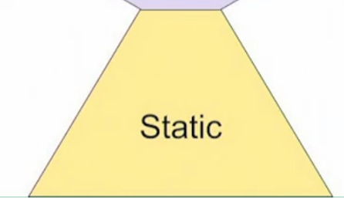


QA: Static Code Analysis
According to coding standards
Consistent
Readable (naming, formatting, length, …)
Maintainable (Code Smells)
Limited complexity
Code Coverage (of tests)
Vulnerabilities (in dependencies)
Automatic improvements

Slide 72
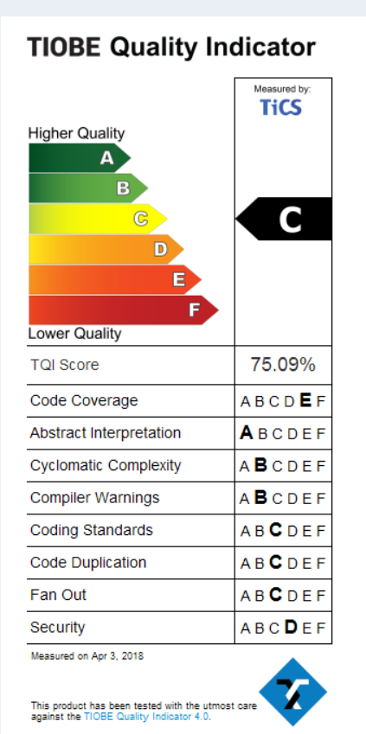
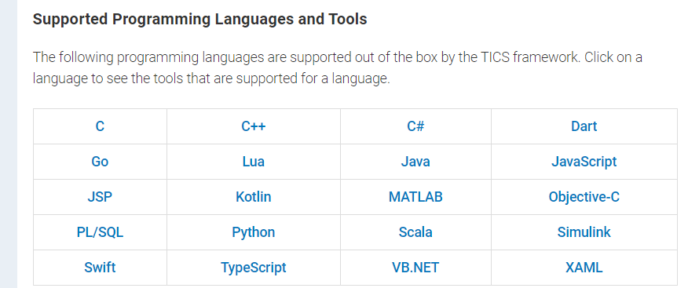
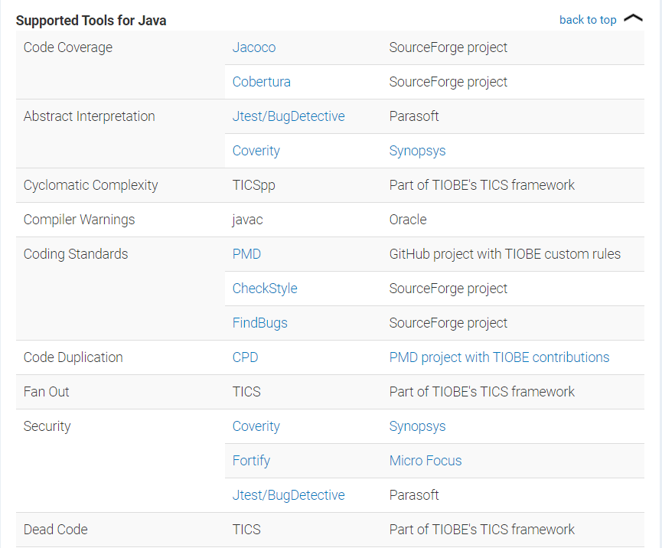
Tiobe TICS
Notes:
https://www.tiobe.com/tics/
Tiobe Quality Indicator: https://www.tiobe.com/files/TIOBEQualityIndicator_v4_6.pdf

Slide 73
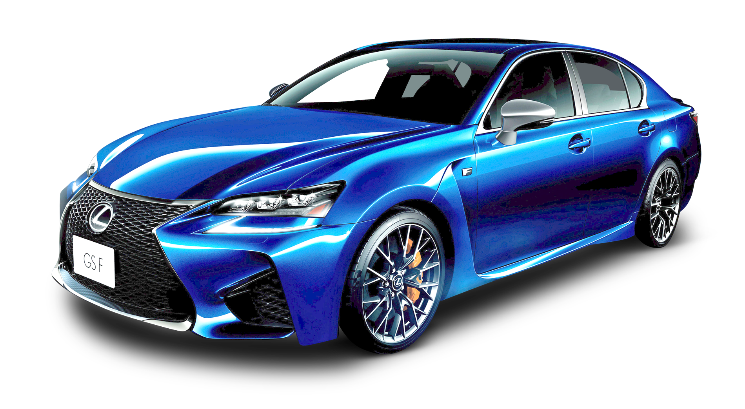
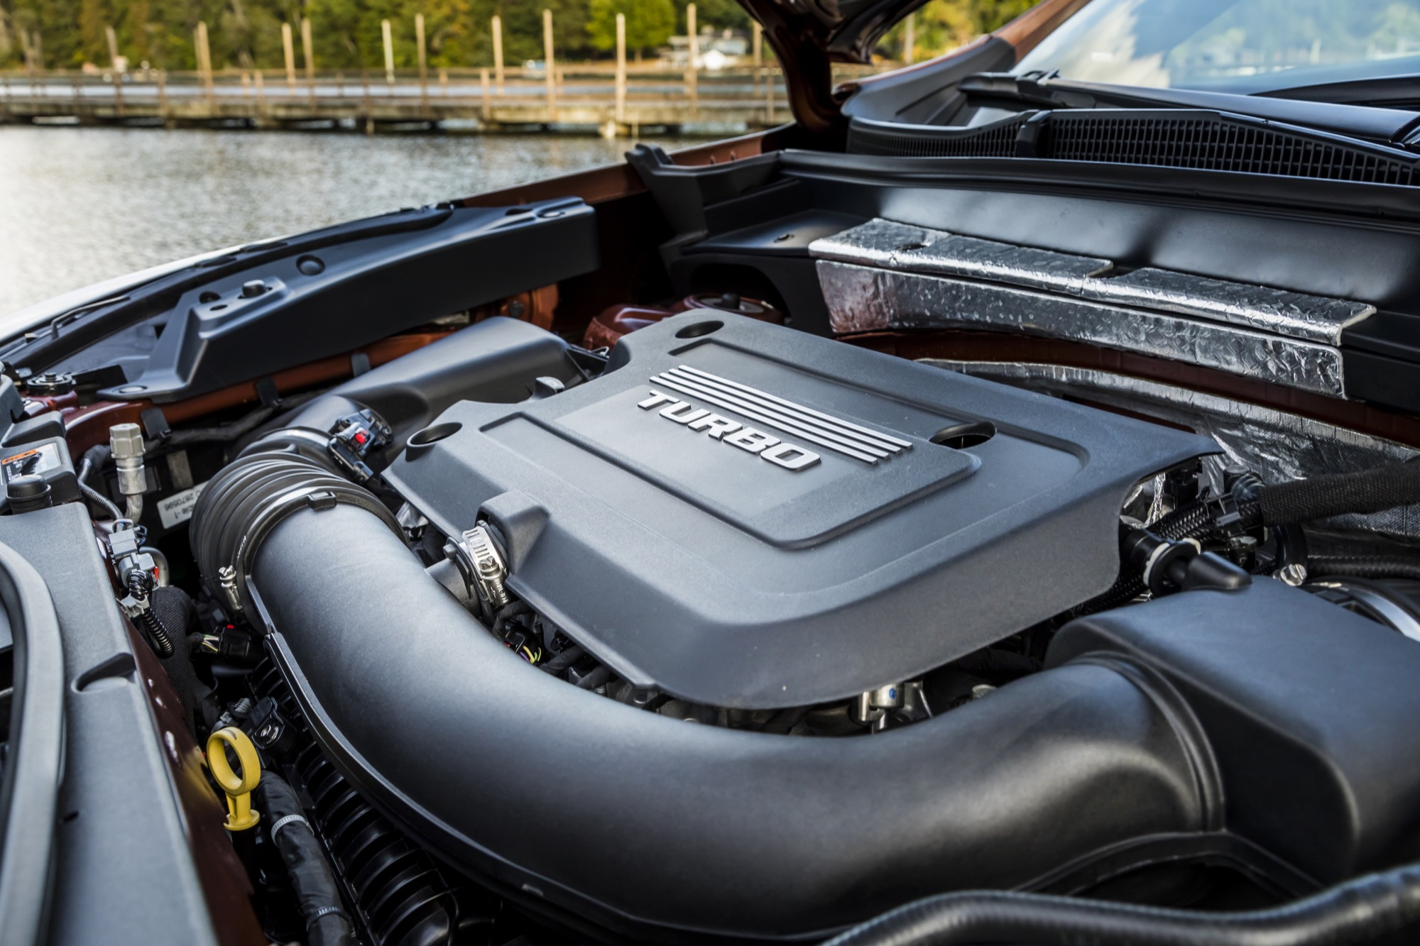
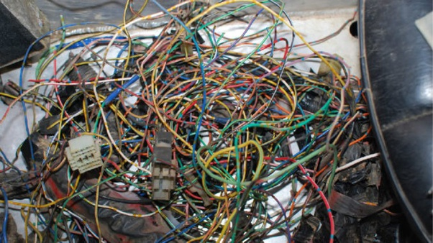
Refactoring

Slide 74
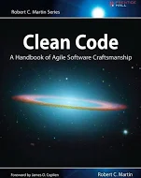
Refactoring towards Clean Professional Code
Compliance with coding standards
Reducing complexity
Increasing readability
Testable & test coverage
Operable
logging
metrics
configuration settings
Life cycle management of technology stack & technical debt
Needed: Local build pipeline and runtime environment to quickly and frequently do code analysis, pull & merge from master, build & automated test
DoaD
Professional Code
Developer
Refactoring
Working Software
Unit tests & QA
(Behavior Tests)

Slide 75

private void calculatePayroll (SpecialList<Employee> employeeGroup) {
while (employeeGroup.HasMore()) {
Employee employee = employeeGroup.getNext(true) ;
employee.updateSalary() ;
Payroll.distributeCheck(employee) ;
}
}
private void process (SpecialList
g) { while (g.
HasMore()) { e =
g.getNext(true) ; e.
updSal
() ; /* discard check for temp workers */ Prl.
disChk(e) ; }
}

Slide 76
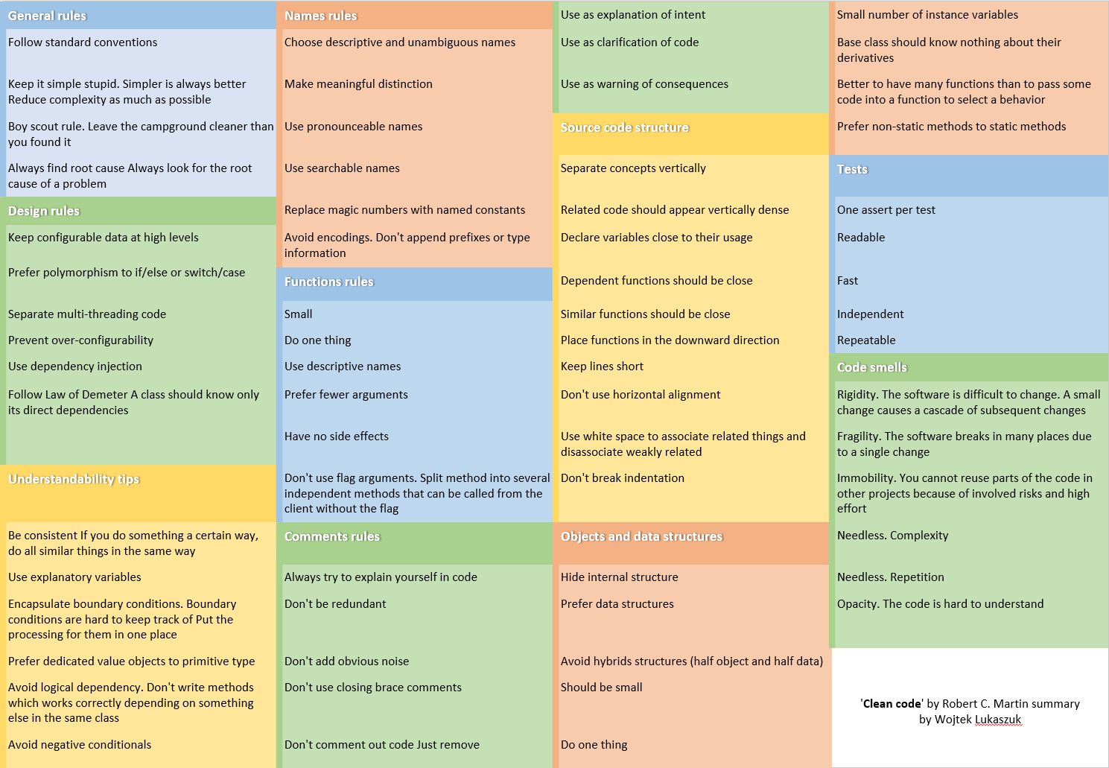
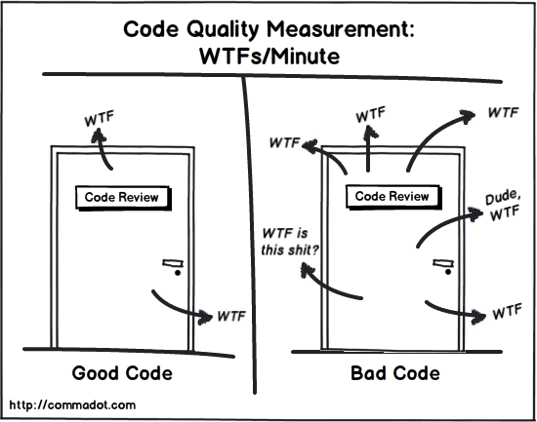
Clean Code Guidelines

Slide 77
Clean Coding Guidelines
Code is as simple as possible
Code reads like well written prose
Code does not contain (m)any surprises (WTFs)
Functions (methods) are small and easy to comprehend
SRP (Single Responsibility Principle for functions)
Low (cyclomatic) complexity
No dead code
Commented out or simply never executed
Naming
Classes, Functions, Variables,Constants, Parameters/Arguments, Exceptions
Clear, consistent (same name for same thing, same formatting for names throughout)
Assertions to validate input to a function
Built-in safe guard and documentation
Only public access when that is really required (encapsulation)
Public-ness introduces a responsibility (that brings costs!)
No premature, unrequested performance optimizations
(but of course no blatantly ignorant designs)
No magic numbers (hard coded values instead of named constants)
Code comments
Are a somewhat poor second best for when code is not clear by itself
Sometimes required for clarification/reference to external source (incident, workaround, …)
Comments can lie – no automated enforcement of being synchronized with the code
Decoupling – minimal number of dependencies
Testable
mockbable (injectable) dependencies
Allow important functions/methods to be ‘stand-alone’ invocable (possibly after a test setup)
Complex private methods should also be testable and tested
Code on Trunk (Master branch) has to be
seen by four eyes (pair programming/code review)
successfully tested - unit, code QA, build and behavior test
validation of code (unit and integration) and behavior (acceptance) has high coverage (both code and spec coverage)
Environment and time or conditional specific characteristics are configurable (at deployment time, possibly even later in life)
non-functional: connectionstrings, endpoints, credentials
functional: exchange rate, promotion on/off, …

Slide 78
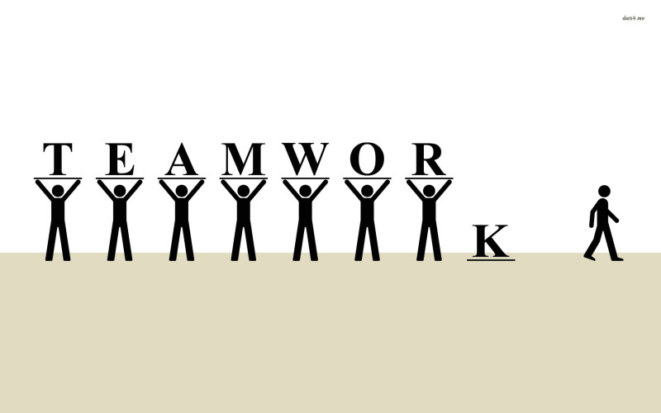
Team
That story is in Janet’s area
Sorry, Tom is on leave so we cannot work on X right now
Our tester is working on running all automated tests
Ellen is the only one on our team who can work on the Python components
Thomas knows how the CI/CD pipelines work
I am not sure what business feature Sophie is working on this sprint
Bob built it, he knows how to demo it
This [one year] old code is hard to maintain because the person who built it has left the team

Slide 79
Metamorphosis – the miracle of the PR
Notes:
Caterpillar to Butterfly
From personal code to team treasure
From branch to trunk
From mine to our

Slide 80
Metamorphosis – the miracle of the PR
PR
Pull Request
Peer Review
Production Ready
Notes:
Caterpillar to Butterfly
From personal code to team treasure
From branch to trunk
From mine to our

Slide 81
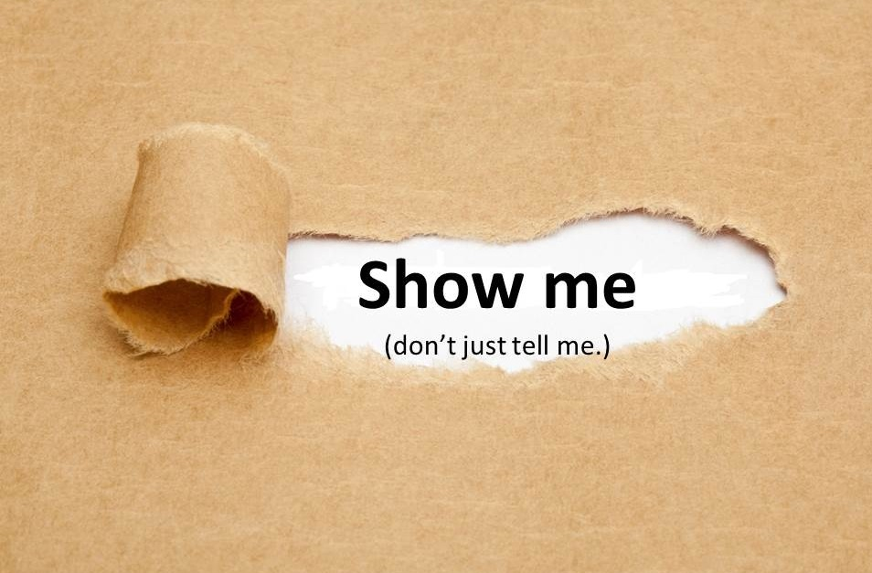
Pull Request == Please Review ?!
DoaD
Team
Professional Code
Developer
Appreciate my work and learn from it
Help me improve it
and become a better developer
Take co-ownership of this code

Slide 82

Peer Review completes the Pull Request
Peer Review completes (only) when
Code is ABLE
and beautiful
the code is merged from the branch to the trunk
and the tram may roll in
because the peer considers the code their own
Give priority to Peer Review!
respond ASAP to Pull Request
a proper Peer Review takes real commitment and substantial time (proportional to the complexity of the story)
Team
Professional Code
Developer

Slide 83
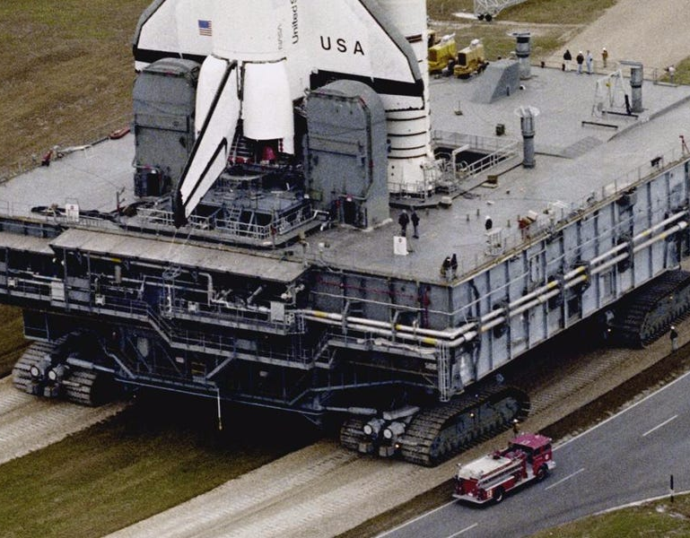
Definition of Almost Done
Code on trunk
ABLE
Compiles | Can be Built
Satisfies
QA
Test (behavior & code)
Non-functional characteristics (absolute & trend)
Vulnerability
Guidelines and Standards
Automated CI/CD pipeline
(covered by) Smoketest
Technical Debt management
Built Software
Professional Code

Slide 84
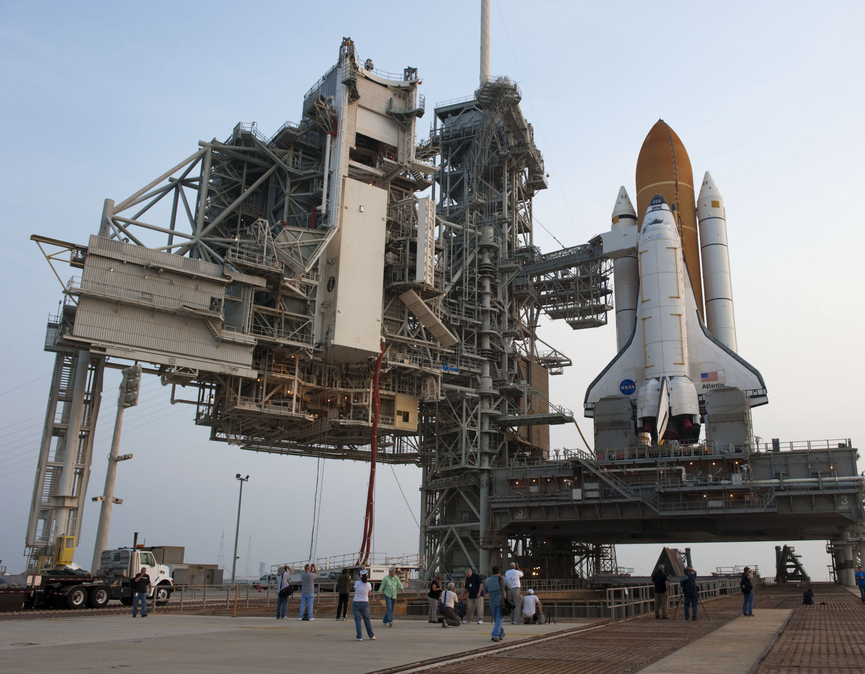
Deployable == Done (as far as team is concerned)
Deployable – but not yet deployed
deploy decision is up to business
CI/Continuous Delivery = fully process up to deployability
Continuous Deployment: automatic roll out when DONE
Deployable Software = DONE
DoD
Built Software
Professional Code

Slide 85

Deploy
Business decision
Automated – no touch
Smoketest post deployment (and periodically to check on health)
Operations activated
Professional & ABLE: Live Software (under Ops)
Production
Preparation
Deployable Software = DONE
Built Software

Slide 86
Smoke test
End to End – on selected, critical functional chains
black box
in acceptance and production
Healthcheck
after roll out and major change in Application and Platform/Infra
periodically to verify health
Functional (proper response and side effects) and non-functional (available, response time)

Slide 87



Canary
Notes:
ultimate test is production
controlled production roll out is one way to perform (final) test

Slide 88

Observe the canary
Notes:
log analysis (splunk, elastic, azure or OCI log analytics)
metrics analysis
real time and trends

Slide 89

Fix Forward
Fast Fix is not a special procedure nor a special environment
Tiered roll out
Spot issue [very quickly]
Assign priority
Define test (to reproduce and guard against regression)
Create fix on branch
working code
professional code
PR and Merge to trunk => DONE
<business decision>
Roll Out

Slide 90

Professional Software – Generating Value for the Business

Slide 91


Slide 92







Software Wears Down

Slide 93

Life Cycle Management – Technical Maintenance
Periodic Review
Ensure the up-date-ness of the application and all its dependencies
Notes:
Elk event leidt tot technical debt en/of actie/user story
DevOps team houdt status bij van applicatie-componenten en platform-onderdelen en tools (functioneel, non-functioneel en technisch

Slide 94
Life Cycle Management – Technical Maintenance
Triggers for technical change – proactively monitored by the DevOps Team
A CEV vulnerability (CVE database https://www.cvedetails.com/) Release (or patch) of 3rd party library/framework New or deprecated (feature in) PaaS Service Custom pricing in used or unused service New specification from the business New non-functional requirement Incident/bug – functional or non-functional Technical debt assessment New version of platform component:
e.g. Docker, Kubernetes, Java, Node
New/custom architecture choice/guideline New/custom coding standard New tool, new version of tool Law & Regulation, Ethical Insights Mere Progression of Time
Periodic Review
Notes:
Elk event leidt tot technical debt en/of actie/user story
DevOps team houdt status bij van applicatie-componenten en platform-onderdelen en tools (functioneel, non-functioneel en technisch

Slide 95
What Time can Do…
Notes:
technical erosion
slowly eating away

Slide 96


PRofessional
Put to Rest
PRide
PRoof
PR
Periodic Review
Push-button Release
Pull Request
Peer Review
Production Ready
oPeRate
PuRpose
Public Relations
Public Responsibility
PR oductive

Slide 97
Thank you for your attention I hope this was useful
lucas.jellema@amis.nl | technology.amis.nl | @lucasjellema | lucas-jellema

